Slide 1
Impact of Cyberattacks on Firm Performance: A Systematic Review
Shreya Gokhale

Slide 2
Agenda
Introduction
Algorithm
Analysis
Synthesis
Future Research

Slide 3
INTRODUCTION

Slide 4
Impact of Cyberattacks
Significant research on impact of cyberattacks on organizations’ market value.
Inconsistent findings, ranging from long-term negative impact to only short-term negative impact to absence of significant impact.
Research Question: What factors drive the different stock market performance outcomes resulting from cyberattack events?
Practical Significance: Understanding these factors can provide insights into the ways to engage companies to invest in developing their cybersecurity strategies.

Slide 5
ALGORITHM

Slide 6
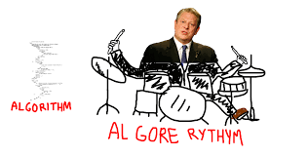
Algorithm for Collection of Articles
Searched articles on Google Scholar
Published in or after 2000
using various combinations of key words and phrases such as “cyber”, “attack”, “breach”, “leakage”, “data”, “firm”, “performance”, “market value”, “stock”, “returns”
Focussed on journals
With impact factor ≥ 1 according to Journal Citation Reports or Web of Science
From areas of finance, marketing, accounting, management, economics, information systems, computers and security
Included relevant articles from SSRN, NBER, HBR
Included articles from conferences, books, or journals with unavailable impact factor with Google Scholar citations ≥ 100
Removed irrelevant articles detected by reading abstract and skimming the article

Slide 7
ANALYSIS OF SELECTED ARTICLES

Slide 8
Selected Set of Articles for Review
Total 42 articles selected
36 journal articles
1 SSRN article
1 NBER article (working paper)
1 HBR article
3 articles from conferences/books/journals with citations ≥ 100

Slide 9
Analysis by Impact Factor and Citations

Slide 10
Analysis by Time

Slide 11
Dependent Variables Used
All except 4 articles, all use Cumulative Abnormal Returns (CAR) as the DV
Other stock market measures used as DV include:
Bid-ask spread
Trading volume
Stock market volatility
Stock price
Some articles use financial measures as DV in addition to stock market measures:
ROA, ROE, ROS, COGS/Sales, Sales growth, Revenue, Cash flows, Leverage, Investments in Capital, R&D, and Acquisitions

Slide 12
Analysis by Impact of Cyberattacks on Stock Returns
Majority of the articles find long-term negative impact.
Almost a quarter of the articles find no significant impact
60% articles find either short-term or no impact of cyberattacks on stock market performance.
Worrying since firms could lose incentives to invest in cybersecurity

Slide 13
Articles Finding Long-Term Negative Impact
Paper | Breach Data Source | Period of Analysis | Dependent Variable | Relationship found | Moderators | Effect of moderators
Cavusoglu et al. (2004) | Lexis Nexis, technology portals CNET and ZDNET | 1996-2001 | Cumulative abnormal return | Decreased | Firm size, Internet vs conventional firms, breach type | Internet firms and smaller firms experienced larger return drop
Gatzlaff and McCullough (2010) | Privacy Rights Clearinghouse (PRC) | 2005-2006 | Cumulative abnormal return | Decreased | Firm size (market capitalization), expected security adherence, refusal to provide information, growth opportunities (market-to-book), previous breach victim, breach at subsidiary firm, breach type | Firms refusing response to data breach inquiries, smaller firms, and firms with higher growth opportunities experienced larger return drop. Parent firms experienced smaller return drops after breach at a subsidiary firm.
Goldstein et al. (2011) | Financial Institutions Risk Scenario Trends (FIRST), by Algorithmics Inc. | 1985 to 2009 | Cumulative abnormal return | Decreased more for function-related breaches as compared to data-related breaches | Breach affecting availability, breach affecting integrity | Function-related events affecting availability rather than integrity experienced larger drops as compared to data-related breaches

Slide 14
Articles Finding Short-Term Negative Impact
Paper | Breach Data Source | Period of Analysis | Dependent Variable | Relationship found | Moderators | Effect of moderators
Acquisti et al. (2006) | Lexis-Nexis, ProQuest | 2000-2006 | Cumulative abnormal return | Decreased in short-term | Breach reported in national media vs local and industry outlets, number of individuals affected in the breach, firm size (stock value), cause of breach, subject of data disclosed | Smaller firms and firms with breaches that affected more than 100,000 subjects experienced larger return drops.
McShane and Nguyen (2020) | Advisen Ltd. Company | 2007-2016 | Cumulative abnormal return | Decreased in short-term | Type of cyber event (DOS, phishing, unauthorized access of customer data), involvement of insider, type of data stolen, type of industry | Firms facing breaches causing immediate business interruption losses, involving insiders, involving loss of credit card and personal data experienced larger return drop. Firms in retail and service industry experienced larger return drops.
Goel and Shawky (2009) | Lexis-Nexis | 2004-2008 | Cumulative abnormal return | Decreased in short-term | NA | NA

Slide 15
Articles Finding No Negative Impact
Paper | Breach Data Source | Period of Analysis | Dependent Variable | Relationship found | Moderators | Effect of moderators
Kannan et al. (2007) | Wall Street Journal, the New York Times, ZDNet, CNET | 1997-2003 | Cumulative abnormal return | Did not significantly decrease in either short-term or long-term | Breach announced in dot-com era, firm size, breach affecting confidentiality vs integrity vs availability | Firms facing breaching in dot-com era experienced larger return drops only in short-term as compared to those facing breaches in dot-com-bust era.
Campbell et al. (2003) | Wall Street Journal, New York Times, Washington Post, Financial Times, and USA Today | 1995-2000 | Cumulative abnormal return | Decreased for breaches involving unauthorized access to confidential data, did not decrease for breaches not involving confidential data | NA | NA
Juma’h and Alnsour (2020) | PrivacyRights.org and Information-IsBeautiful.net | 2005-2017 | Change in ROA, ROE, stock prices | ROA, ROE decreased, stock prices did not show significant relationship | NA | NA

Slide 16
SYNTHESIS

Slide 17
Organizational Factors
Contributing to Negative Long-Term Impact | Decreasing Negative Long-Term Impact
Smaller firms in terms of assets, market capitalization | Investment in technology, cybersecurity, staff training
Higher growth opportunities or rapidly growing firms | Firms showing high degree of transparency in the collection and use of personal information
Higher leverage, operating profit, Tobin’s Q, market-to-book ratio | Firms giving users higher degree of control over selection of information that can be shared
Being previous breach victim | Being the parent firm of a subsidiary that was breached
Refusal to respond to data breach inquiries | Being rival of a severely breached firm
Greater social media exposure or media visibility at the time of the data breach incident | Firms providing immediate notification regarding efforts to control the amount of information disclosed and compensation for affected individuals.
Firms from highly competitive markets | Sector: Consumer goods, communication
Sector: Financial, technology, retail, service, | -

Slide 18
Cyberattack-related Factors
Contributing to Negative Long-Term Impact | Decreasing Negative Long-Term Impact
Greater severity in terms of number of records leaked or manipulated (≥ 100,000 records affected) | Attack executed by external malicious actor as opposed to an insider
Breaches affecting confidentiality (leading to loss of personally identifiable or sensitive information of customers/employees such as SSN, credit card details, bank account details, health information) | No leakage of confidential information regarding customers
Breached affecting availability as opposed to integrity | Being the parent firm of a subsidiary that was breached
Breaches leading to immediate business or functional disruption (such as DOS attack) as opposed to loss of data | Announcing data breach strategically, on days with higher news pressure
Breached resulting from phishing | Cyberattack disclosed as soon as it was detected by the firm
Breached involving lost devices | -
Greater time between occurrence and public disclosure of the cyberattack event. | -

Slide 19
FUTURE RESEARCH

Slide 20
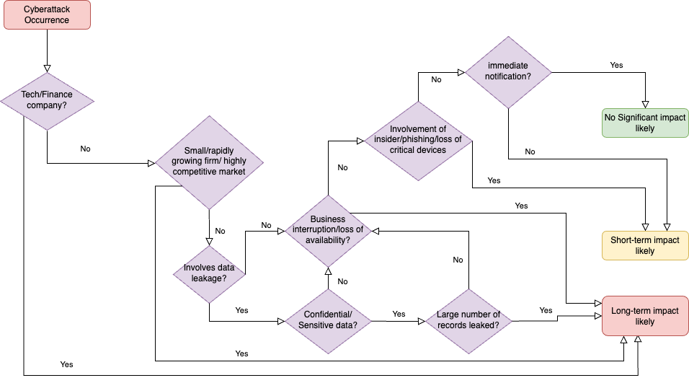
Future Research Ideas
Research on conditions under which a specific firm suffering from a specific breach is likely to face a long-term/short-term/ no impact.

Slide 21
Future Research Ideas
For conditions not likely to cause a long-term negative impact:
investigate other firm outcomes that are significantly affected after cyberattacks
suggest incentives/policies that can drive such firms to invest in cybersecurity.

Slide 22
THANK YOU
Comments/QUESTIONS?

